Slide 1
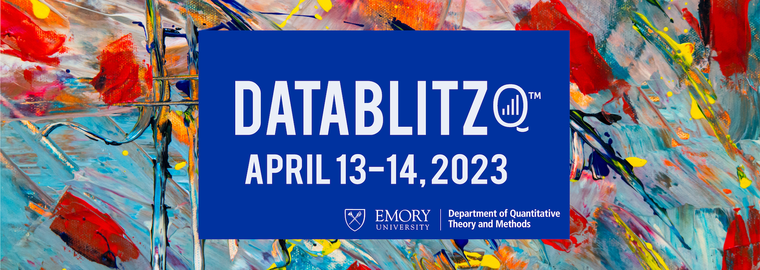
DataThink: Better Business Bureau

Slide 2
Project Strategic Vision
The goal of this project is to perform an analysis on Membership data from BBB’s Interactive Blue system and deliver insights & recommendations focused on reducing cancellations.
Final deliverables include:
This presentation of insights and recommendations
A Tableau-based data product allowing BBB to more easily analyze the data we used to come to our conclusions

Slide 3
Insights

Slide 4
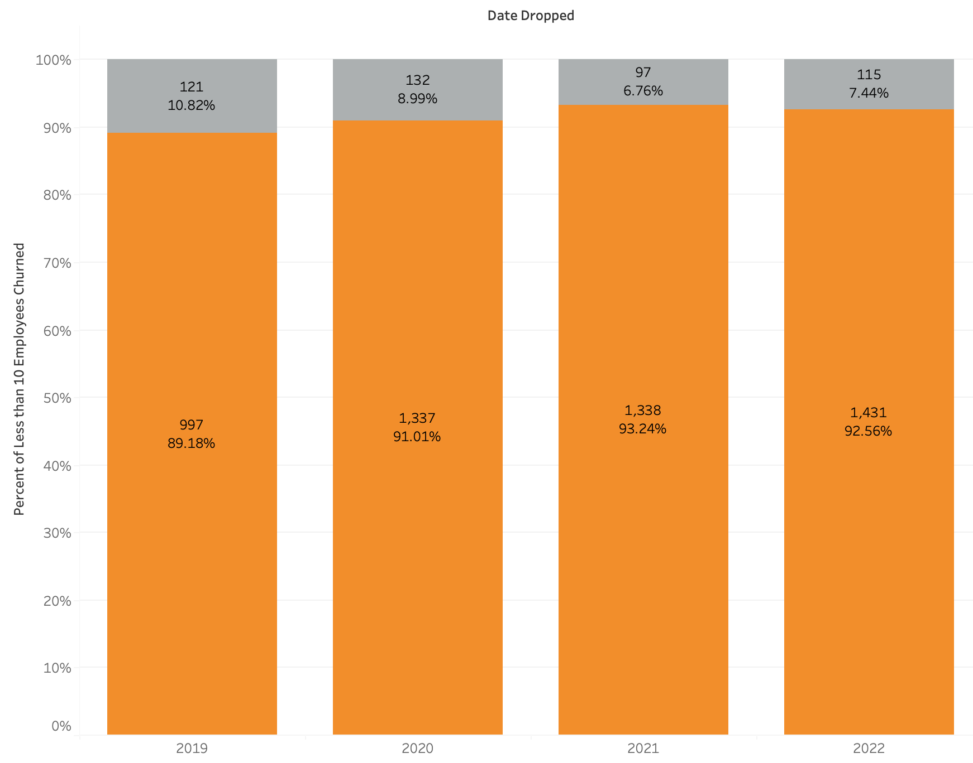
Low-Employee Count Churn Rate
Majority of churned customers come from companies with 10 or less employees
2019: 89.18%, 2020: 91.01%, 2021: 93.24%, 2022: 92.56%

Slide 5
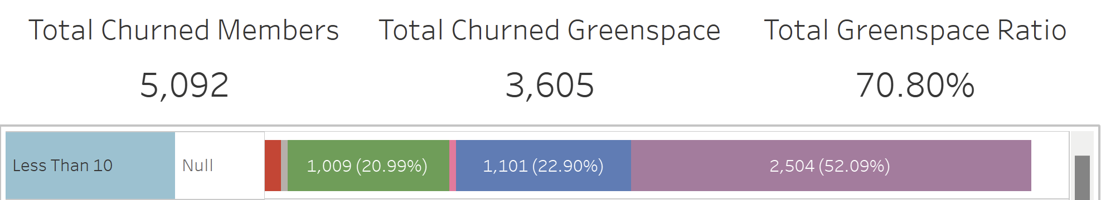
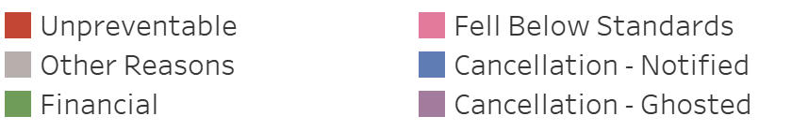
Preventable Churn
We grouped together different churn reasons in order to better analyze patterns in churn.
Cancellations (notified or ghosted) are considered to be “preventable”.
The ratio of preventable churn reasons is what we are assuming to be our “Greenspace” for churn reduction
70% of all 1-10 Employee Churn are for preventable reasons, but 52% of this churn (3/4th of preventable churn) are from former customers that “Ghost” BBB

Slide 6
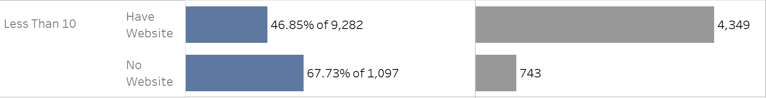
No Website, No Retention
It is well known that BBB customers without a website are far more likely to churn than those that do.
96% of churned companies without a website are companies with less than 10 employees

Slide 7
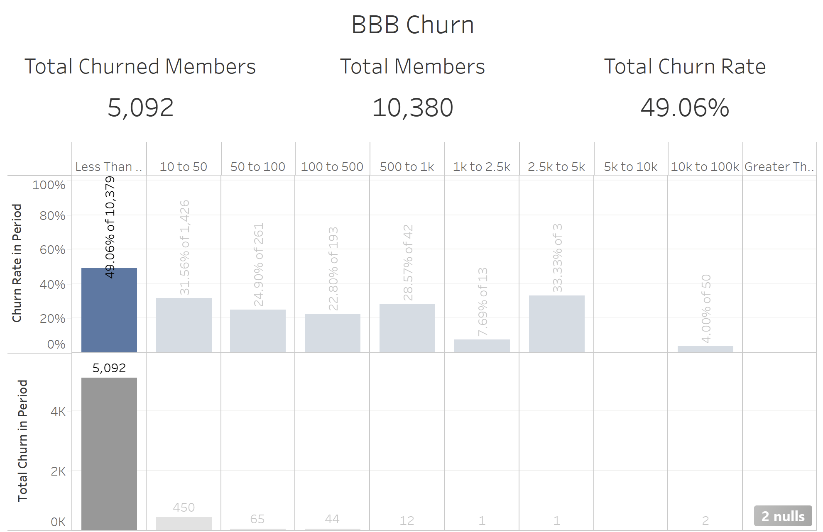
Low-Employee Count Churn Rate
Within the 4 year period we analyzed, half of all businesses under 10 employees churned.
It is clear that any progress in decreasing churn is going to come down to increasing retention with companies less than 10 employees.
RECOMMENDATION:
Look for subsections with less than 10 employees with strong indicators of intention to focus retention team on

Slide 8
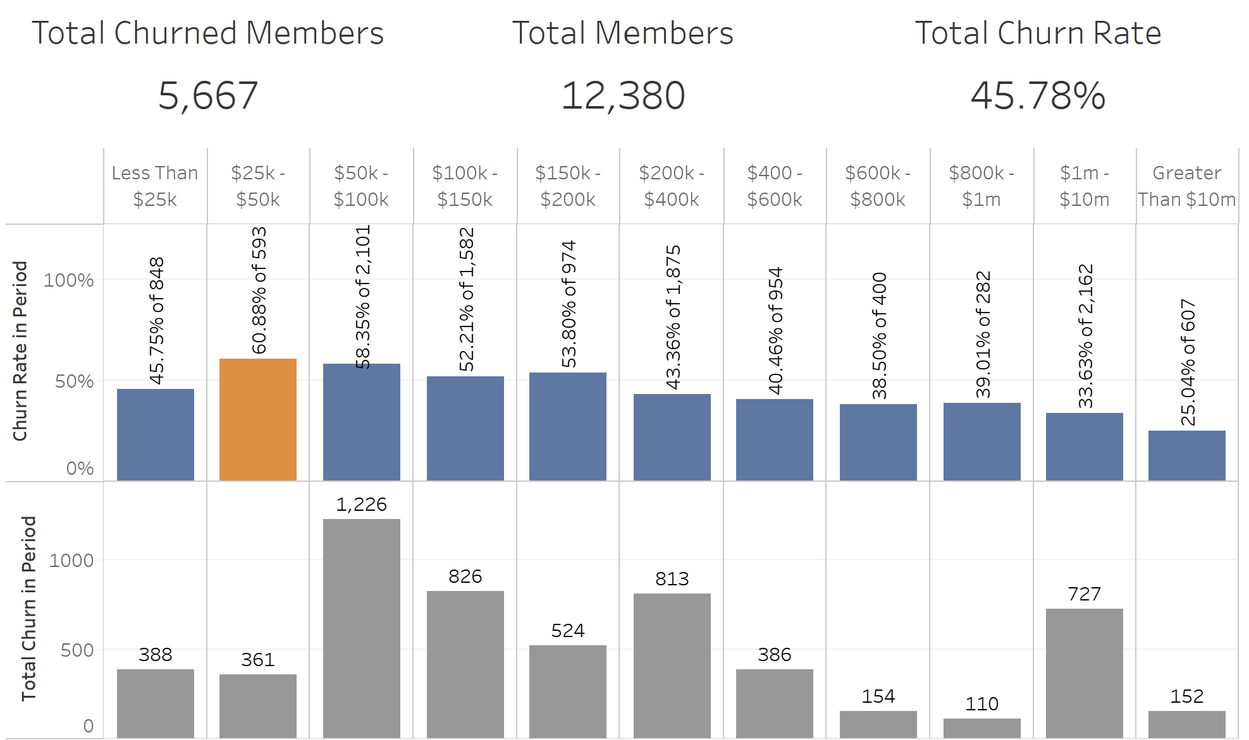
Annual Revenue Is Sticky
Unlike Employee Count where churn is uniquely centralized in companies with 10 employees or less, churn is more evenly distributed across various bands of annual revenue.
Churn peaks for companies with between $25k-50k in annual revenue and then gradually falls. Only 25% of companies with more than $10m annual revenue churn.

Slide 9
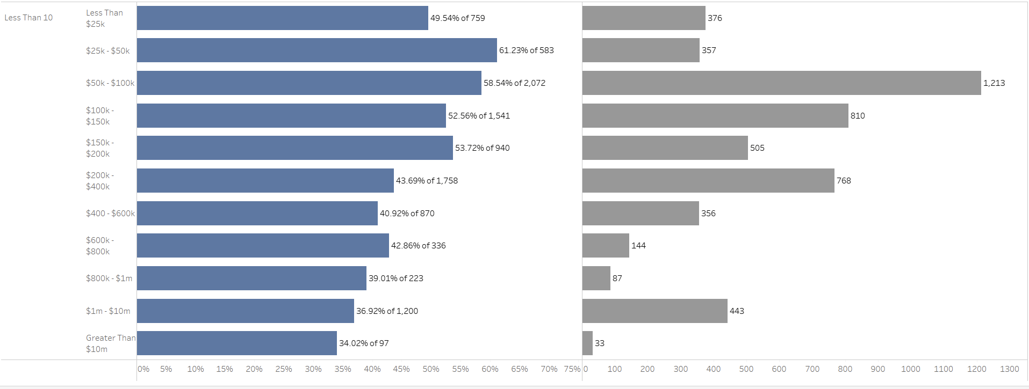
Annual Revenue Is Sticky
There is a large cluster of companies with less than 10 employees but greater than $1m in annual revenue that churn
RECOMMENDATION: Focus the retention team on companies with Less than 10 Employees and greater than $1m in annual revenue. These business owners are likely already used to “white glove” service and will be more responsive to direct attention.

Slide 10
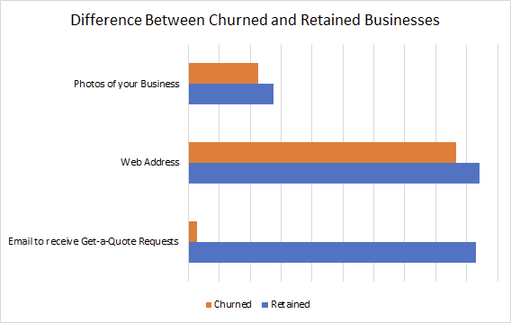
Emails to Receive Get-A-Quote Requests
The Email to receive Get-A-Quote Request is one of the key features of the BBB Membership to help accredited businesses gain exposure.
Just 2.77% of businesses who churned had this email, compared to 93.10% of retained accredited businesses.
Nearly all companies have a public email, at least 98% for both accredited and dropped.
RECOMMENDATION:
Emphasize an Email to receive Get-A-Quote Requests over other factors.
Make it part of onboarding
Make automated email to fill in
Notes:
Low effort tasked for companies to do, very easy
Given low effort, makes sense to encourage people to get it filled out

Slide 11
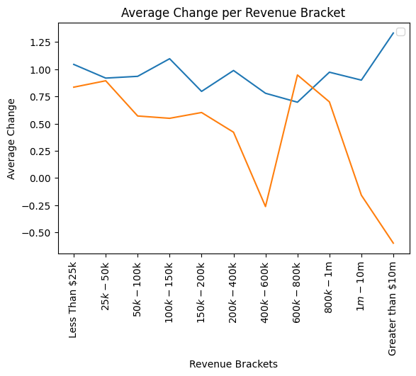
Rating Change Churn
Companies who have churned tend to have lower change in their rating.
Companies who are smaller experience this to a greater extent
In the graph the Churned line, which is orange, is almost always lower in rating change
RECOMMENDATION:
Focus on informing smaller companies about the benefits in order to give them reassurance

Slide 12
Lessons Learned

Slide 13
BBB Project Takeaway: Richard Jensen
Real-world data can be messy and difficult to interpret
It is easy to get stuck going down a rabbit hole topic that will never come to fruition instead of looking at the bigger picture
Use the data to drive conclusions instead of molding the data to fit your own hypothesis; do not work backwards
Notes:
These are mistakes that I learned while working on this project, and I now know not to make these blunders during a final project for a class or during my first internship, so I am grateful for the opportunity.

Slide 14
BBB Project Takeaway: James Park
First time participating in a data science project
Wonderful working with like-minded peers and a great advisor
Learned the process of finding, analyzing, and even altering insights: had to change from looking into websites to checking employee count

Slide 15
BBB Project Takeaway: Juan Orozco Diaz
Importance of attempting and failing.
Allowed me to learn the process of data analysis and how to reach a conclusion.
Learned my strengths and weaknesses.

Slide 16
BBB Project Takeaway: Manny Bettencourt
I was able to apply what I learned in class quite nicely by expanding on particular subjects
One thing that I had trouble with is finding the right story to tell and how to tell it.
One of the things that I found easier to do was the actual coding of the project.

Slide 18

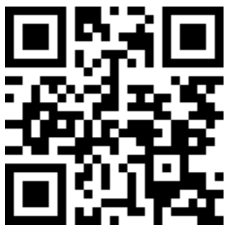
DataThink:
Better Business Bureau
For extra credit:
Use QR code to go to attendance polls

